Slide 1
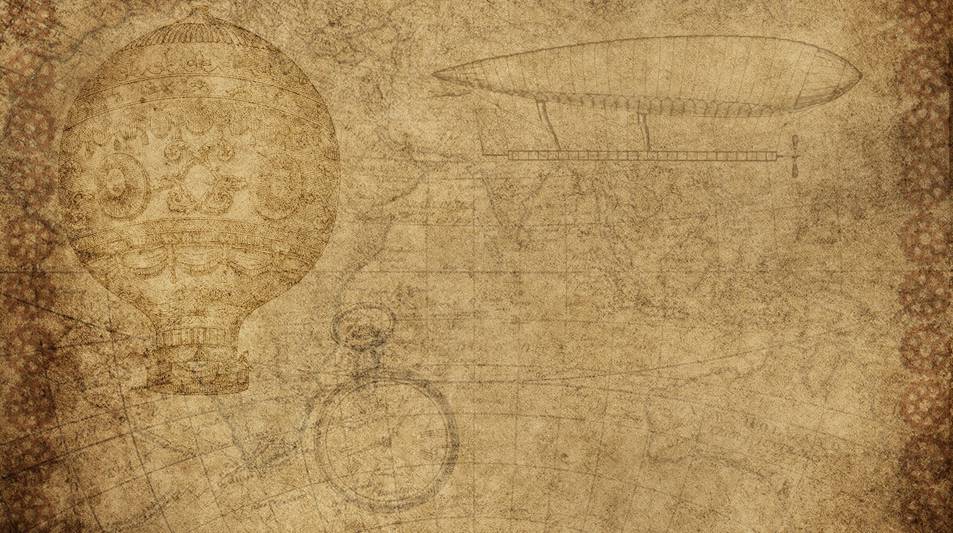

K-NEAREST NEIGHBOURS
Group:
Asish joel – 202103015
Aaditya meher – 202103024
Raj kariya - 202103048
Instructor: Prof. PM Jat

Slide 2

Objective and motivation
The main motivation was to emphasize the need for scalable and distributed computing frameworks to handle big data efficiently, since we know that kNN is fundamental machine learning algorithm used for classification and regression tasks.
Our Objective is to:
Implementation of kNN algorithm using the MapReduce framework
Implementation of kNN algorithm using Apache Spark
Comparing the efficiency of both the approaches based on the runtime and effect of maps and reducers

Slide 3

Learning outcomes
The project provided valuable insights into the efficiency of the kNN algorithm when implemented in Apache Spark and MapReduce.
The study aligns with current industry trends emphasizing the importance of scalable and efficient machine learning algorithms in big data analytics.
Gained a deeper understanding of distributed computing concepts and their practical applications in big data processing.

Slide 5

Invention Materials
Materials used for final invention build
Why did you choose those materials?

Slide 6
References
<Insert pictures or drawings of your invention design/building process>
*you can insert a new slide for these pictures/drawings if you need to!

